Slide 1

Potential Data Gaps & Summary of Various Groundwater Management Zone Activities
Basin Monitoring Program Task Force
July 28, 2025
Ian Achimore
Interim Planning Department Manager

Slide 2
Purpose of Presentation
Brief Task Force on past work done related to potential groundwater data gaps.
Highlight recent activities of groundwater management zones (GMZs) labeled “high priority” with ≥1 potential data gap.
The State-wide 2019 Recycled Water Policy and the Santa Ana Region’s Basin Plan are both covered in this presentation.

Slide 3
Reason for Focus on Data Gaps
Section 6.2.4 of the 2019 Recycled Water Policy is related to Salt and Nutrient Management Plan (SNMP) monitoring networks.
The policy states “Each salt and nutrient management plan shall include the following components….
Sub-Section 6.2.4.1: “A basin- or subbasin-wide monitoring plan that includes an appropriate network of monitoring locations to provide a reasonable, cost-effective means of determining whether the concentrations of salts, nutrients, and other constituents of concern as identified in the salt and nutrient management plans are consistent with applicable water quality objectives...” and
Sub-Section 6.2.4.1.3“The monitoring plan shall identify those stakeholders responsible for conducting, compiling, and reporting the monitoring data.”

Slide 4
Relationship of Potential Data Gaps and This Task Force’s Ambient Water Quality Monitoring
To track compliance with the Basin Plan TDS and Nitrate (N) antidegradation objectives, the Basin Plan SNMP includes monitoring program requirements for both surface water and groundwater (gw). For gw, Basin Plan requires –
    Periodically recompute current ambient water quality (AWQ) and assimilative capacity for the groundwater management zones (GMZs).
  AWQ Recomputations use gw monitoring data over 20-year periods.
    More difficult to compute AWQ with potential gw data gaps.
As a reminder, and to relate this regional monitoring effort to dischargers, AWQ helps determine if any new or revised regulatory actions (e.g., revisions to NPDES permits or WDRs) may be necessary.
Task Force AWQ Recomputation History
Name | 20-Year Period Used
Initial Computation | 1978 to 1997
2000 AWQ Recomputation | 1981 to 2000
2003 AWQ Recomputation | 1984 to 2003
2006 AWQ Recomputation | 1987 to 2006
2009 AWQ Recomputation | 1990 to 2009
2012 AWQ Recomputation | 1993 to 2012
2015 AWQ Recomputation | 1996 to 2015
2018 AWQ Recomputation | 1999 to 2018
2021 AWQ (Pilot) Recomputation | 2002 to 2021
2026 AWQ Recomputation (Not Begun) | 2007 to 2026

Slide 5
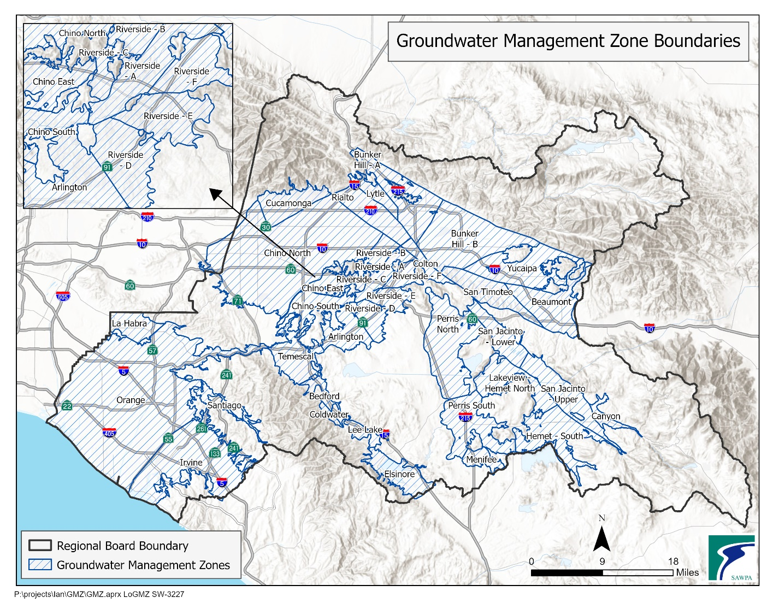

Slide 6
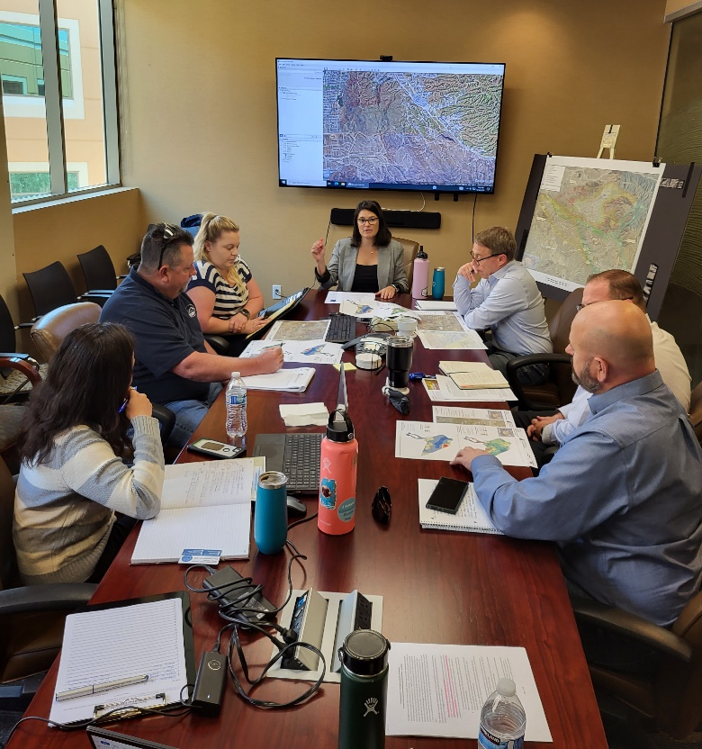
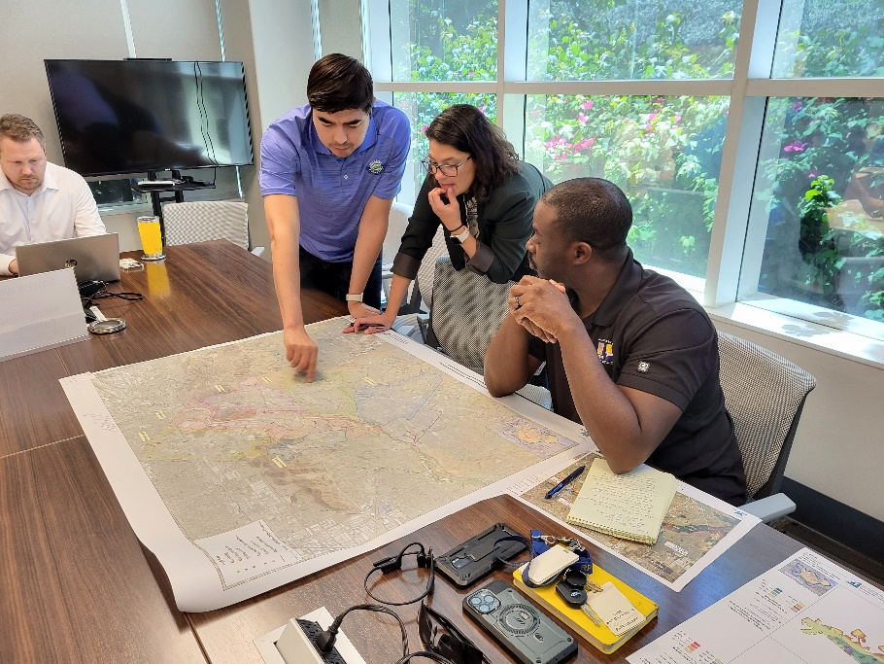
Framework Development Timeline
Task Force approved $59K March 2023 contract with West Yost (WY).
SAWPA/WY held meetings with the Regional Board, Task Force members, and other local agencies to discuss monitoring networks in each GMZ in May 2023
  Led to table with list of groundwater management zones (GMZs), amount of potential data gaps, and prioritization.
SAWPA/WY met with the Regional Board in July 2023 to review discussions and key considerations for identifying agencies designated for resolving potential data gaps.
2023 Data Gap Framework comment period ended on October 13, 2023.
Framework submitted to Regional Board on October 31, 2023.

Slide 7
Updates for “High Priority” GMZs
With ≥1 Potential Gap
San Jacinto Lower Pressure
Hemet South
Menifee
Beaumont
Riverside-A
Arlington
Cucamonga
Chino-North
Chino-East
Chino-South
Temescal

Slide 8
Updates for “High Priority” With ≥1 Potential Gap
The various approaches being employed by GMZs include -
Hiring consultants to assist in reviewing available data and the possibility of locating additional wells.
Meeting with Santa Ana Board and preparing a TM summarizing the proposed approach (utilizing existing monitoring wells).
Coordinating with non-Task Force members on their existing wells.
Determining if existing wells for groundwater levels can be altered for sampling
Developing an approach in tandem with a monitoring work plan (which is drafted for the GMZ’s individual SNMP).
Evaluating whether older unused monitoring wells can be repurposed.

Slide 9
Data Gap-Related Schedule
Ambient Water Quality (AWQ) Recomputation | Recomputation Period | Deadline to Finish
2021 AWQ | 2002-2021 | Oct 2023
Assess and Plan for Potential Data Gaps |  | Dec 2025*
October 2023 – Final TM on Potential Data Gaps Analysis and Framework to Address Data
By December 31, 2025 – 11 GMZs follow steps in the Framework (i.e. Section 3.4)

Slide 10




Thank You
Ian Achimore
Santa Ana Watershed Project Authority
Office (951) 354-4233
ian@sawpa.gov
sawpa.gov
@sawpa_water
@sawpatube

