Slide 1
Monitoring Plan
Special Study of Total Dissolved Solids for Santa Ana River Reach 3
STATUS UPDATE
JULY 28, 2025
SUBTITLE HERE
Notes:
To change background photo, Right Click > Format Background

Slide 2
Project Overview
Goal:
  Understand why there are fluctuating TDS concentrations during base flow conditions at the downstream terminus of the SAR Reach 3 area of interest.
Objectives:
Update Mass Balance Calculation
Coordinate with Groundwater Managers in the Reach 3 Area
Develop a Monitoring Plan

Slide 3
Task 1 Status
Review Existing Data/Documents COMPLETED
Data Collection & Validation IN PROGRESS (LOE ~ 18 Hours)
Mass Balance Calculations for 2017-24 IN PROGRESS (LOE ~ 30 Hours)
  Two Base Flow Definitions
Technical Memorandum NOT STARTED

Slide 4
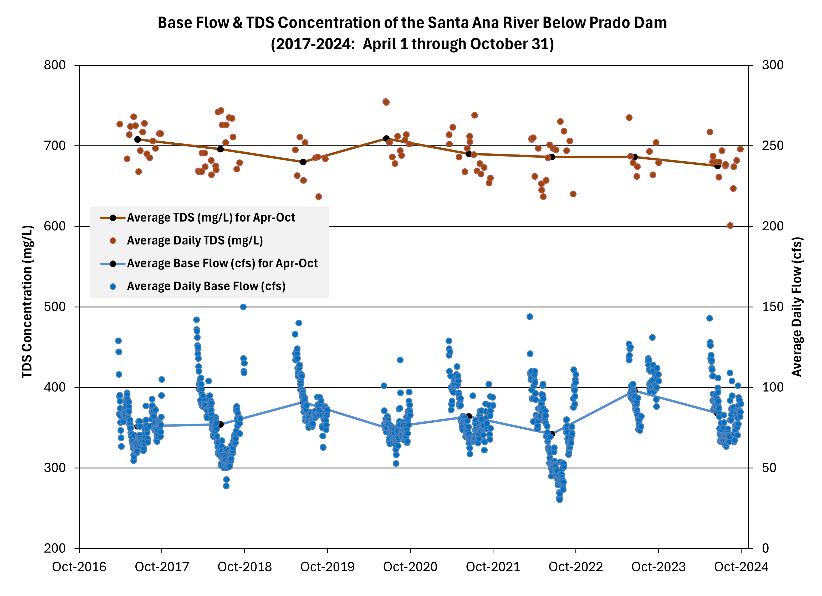
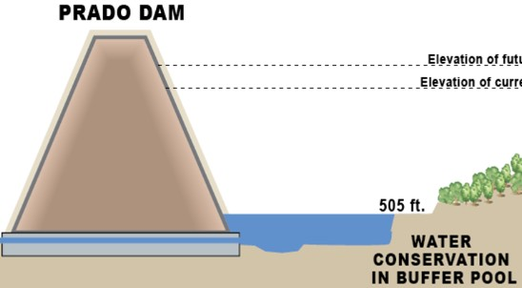
Base Flow Definition 1:
April 1 through October 30
No precipitation
No OC-59 discharges
Water level in Prado Dam Conservation Pool at/below 472 ft amsl

Slide 5
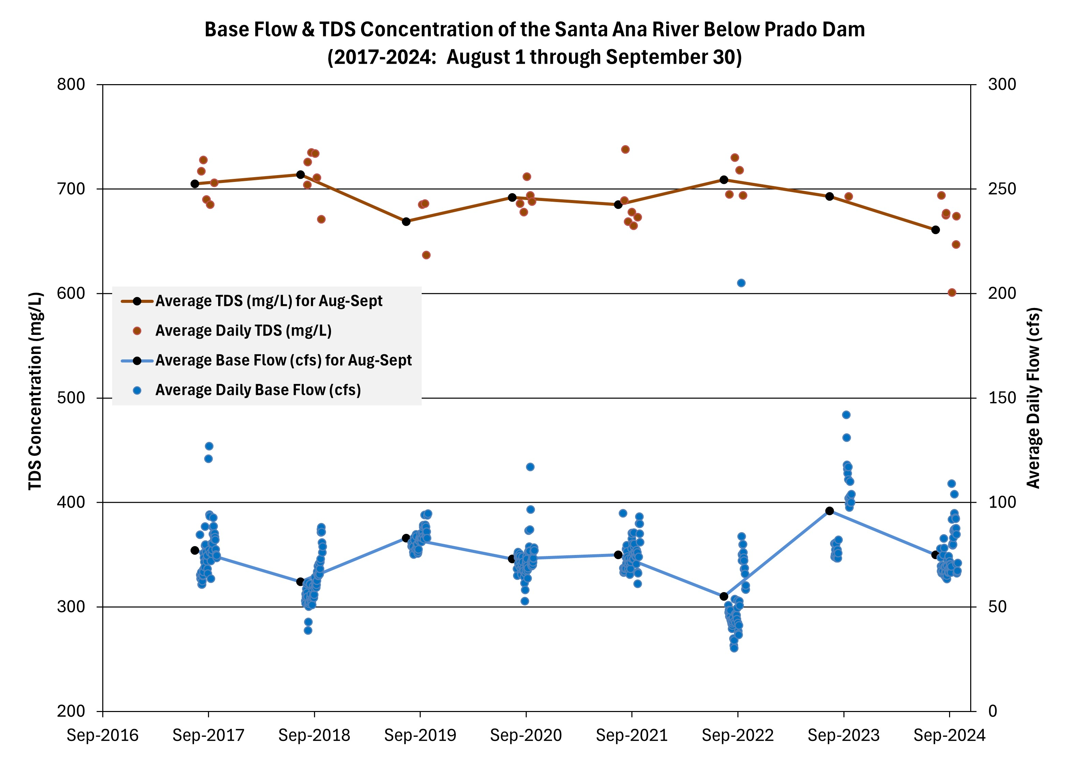
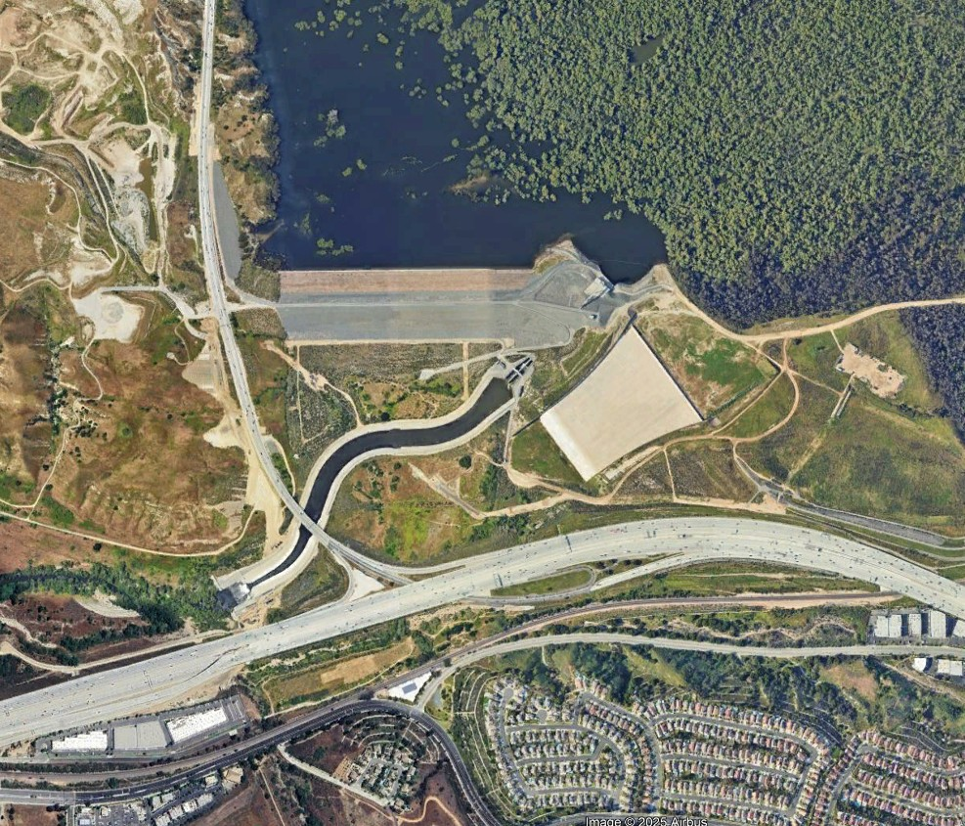
Base Flow Definition 2:
August 1 through September 30
Prado Dam
SAR Below Prado Dam
(11074000)

Slide 6
Next Steps & Schedule
Complete Flow/TDS Time-Series END OF JULY
Mass Balance Calculations WEEK OF AUG. 4
Draft Technical Memorandum SUBMIT FOR REVIEW LATE-AUGUST

