Slide 1
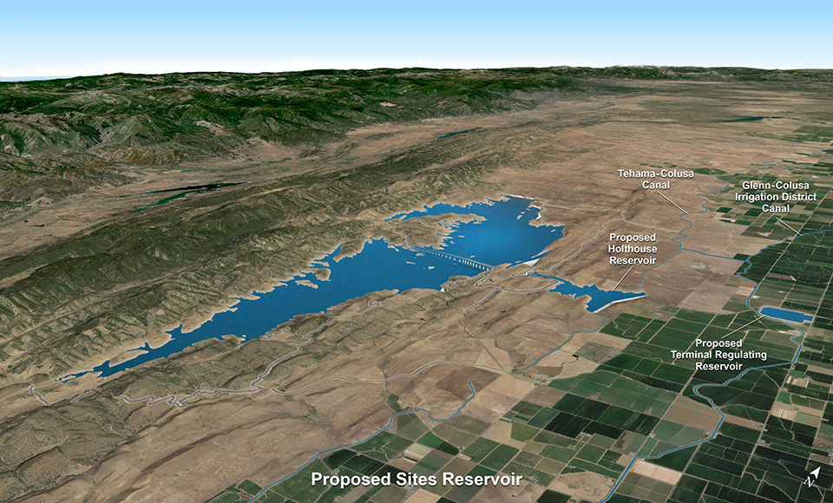
Sites Reservoir Project:
Water Supply Investment Overview
2016

Slide 2
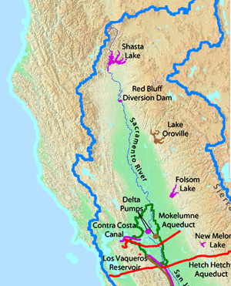
Sacramento Valley Watershed
Water source
Unregulated tributaries
1977 Water Rights application
Proposed Sites Reservoir
1957 Water Plan
as a local storage project
~ 75 miles northwest from downtown Sacramento
2016 January
Draft, planning phase concepts

Slide 3
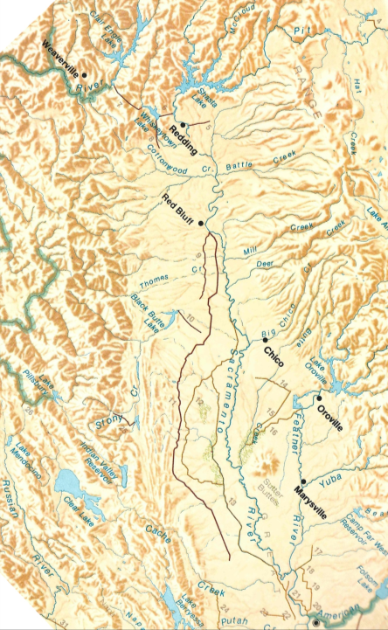
Project Location
Tehama-Colusa Canal
Glenn-Colusa Canal
Sites Reservoir
Sacramento

Slide 4
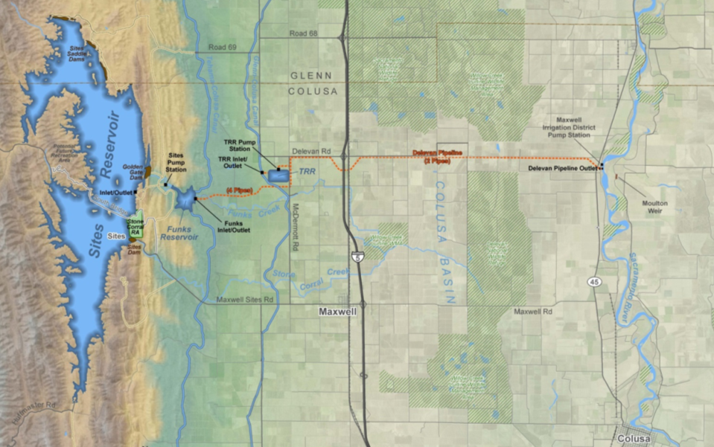
Facilities: Overview
From Red Bluff
(TC Canal)
From Hamilton City
(GCID Canal)
Storage capacity:
1.3 to 1.8 M acre-ft.
From Sacramento River (Proposed)
2016 January
Draft, planning phase concepts

Slide 5



Facilities: Schematic
Sites Reservoir (N)
Sacramento River Diversions
2,100 cfs TC Canal (E)
At Red Bluff (E)
+ 2
Pumps (N)
1,800 cfs GCID Canal (E)
At Hamilton City (E)
Holthouse Reservoir (N)
Terminal Regulating Reservoir (N)
Delevan Pipeline (N)
At Mile Post 158.5 (N)
Source: DWR Report (2013 Dec), Appendix H: Power Planning Study, Figure H.4-2. NODOS Project, Schematic of Conveyance and Storage Interconnection

Slide 6
Why Sites?
If Sites operated in 2016
*
© CA Rice Commission
* Through Feb 25
2016 January
Draft, planning phase concepts

Slide 7
Water Supply Benefits: Reservoir Storage
(DWR Alternative C) By Water Year Type
2016 January
Draft, planning phase concepts

Slide 8
Water Supply Benefits: Refill Frequency
(DWR Alternatives)
On Average, every 3 to 5 years
Simulated hydrologic sequence (1921 - 2002) with water demand in year 2030
2016 January
Draft, planning phase concepts

Slide 9
Why Sites?
If Sites operated in 2015
With drought conditions, water available to increase storage:
Storage Percent
Reservoir (acre-ft.) increase
Shasta 240,000 12.1
Oroville 105,000 7.1
Folsom 37,000 9.6
Trinity 79,000 8.5
Sites 660,000 (*)
Total 1,121,000 23.4
Indirect Benefits
Direct Benefit
While meeting the existing water quality and flow obligations of the CVP & SWP
(*) This water is independent of CVP & SWP water contracts
2016 January
Draft, planning phase concepts

Slide 10
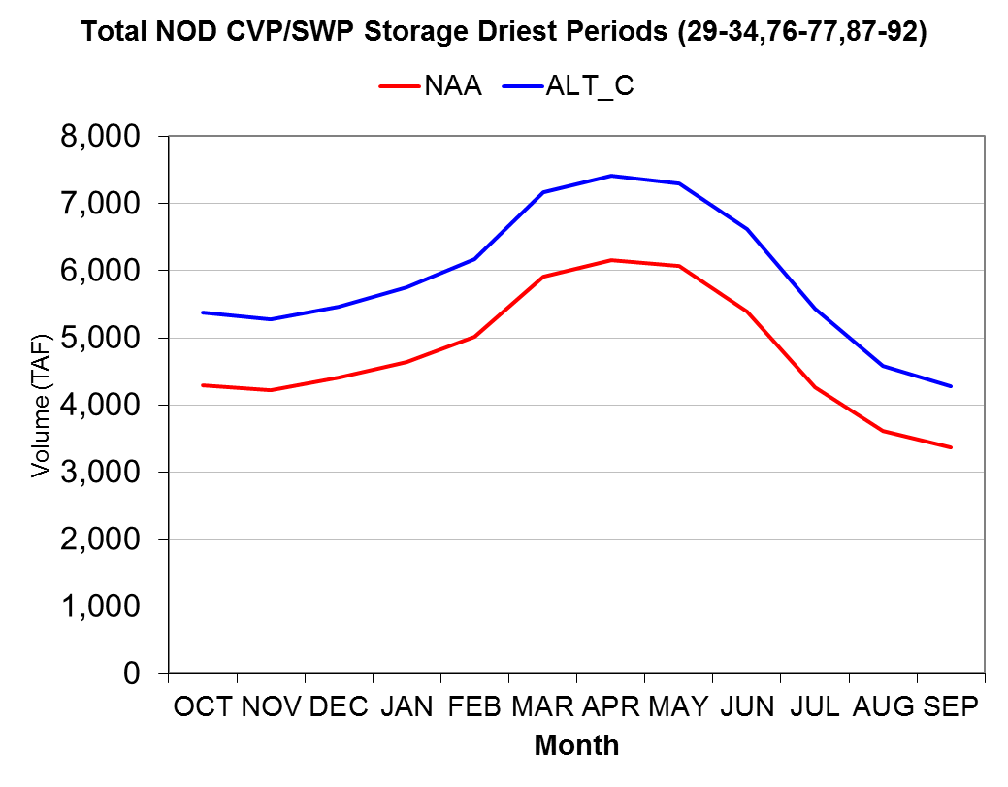
Context: Water Supply Benefits
Monthly Storage (Shasta, Oroville & Sites)
>1,000,000 acre-ft.
Status: | Conceptual | Version: | B
Purpose: | Prepare by Sites to facilitate communications | Date: | 2016 April 27
Caveat 1 | Working Draft, Subject to change | Ref/File #: | P31. 12.235
Caveat 2 |  | Page: | 10 | of

Slide 11
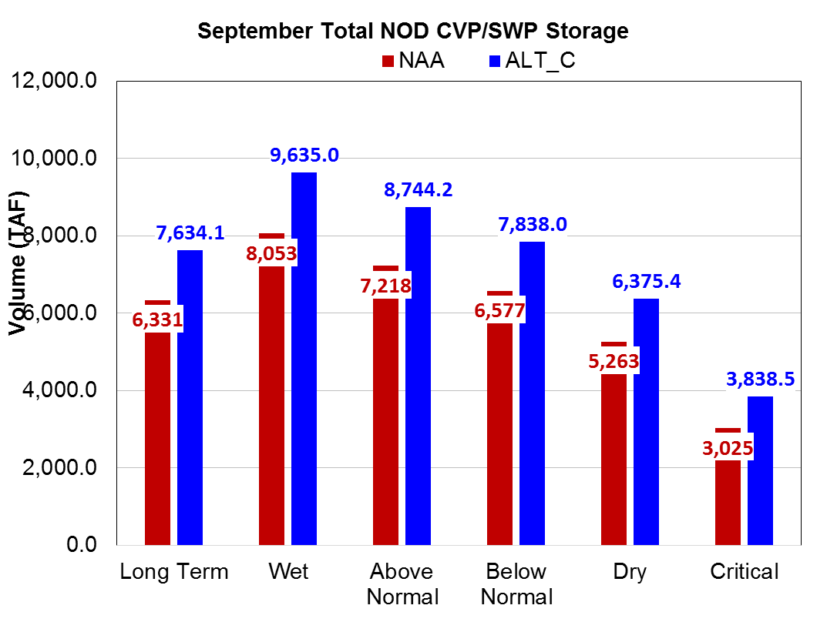
Water Supply Benefits: By Water year Type
(DWR Alternative C) (Shasta, Oroville & Sites)
303. 1,582. 1,526. 1,261. 1,112. 814.

Slide 12
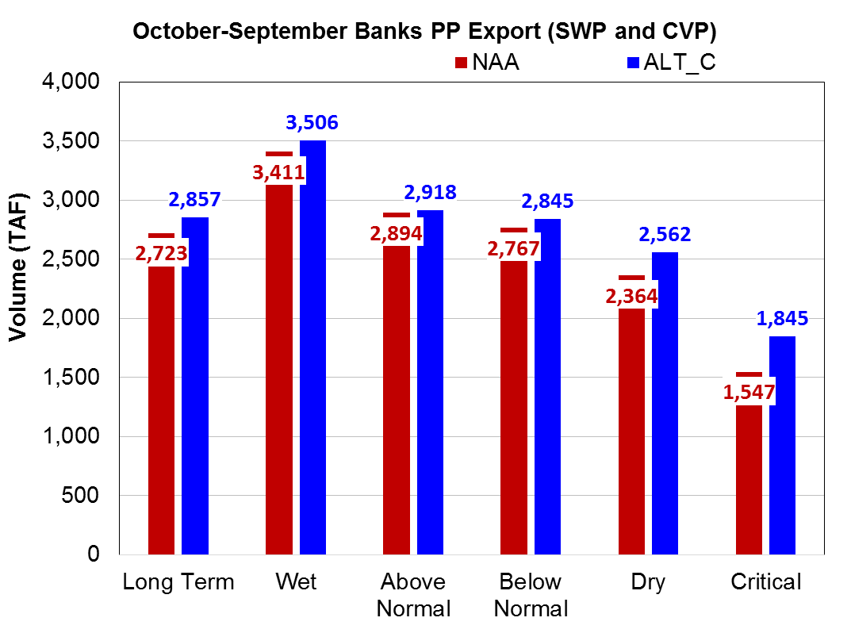
Water Supply Benefits: By Water year Type
(DWR Alternative C)
Does not include transfers
Existing CVP & SWP
Additional from Sites Reservoir
134. 95. 24. 169. 198. 298.

Slide 13
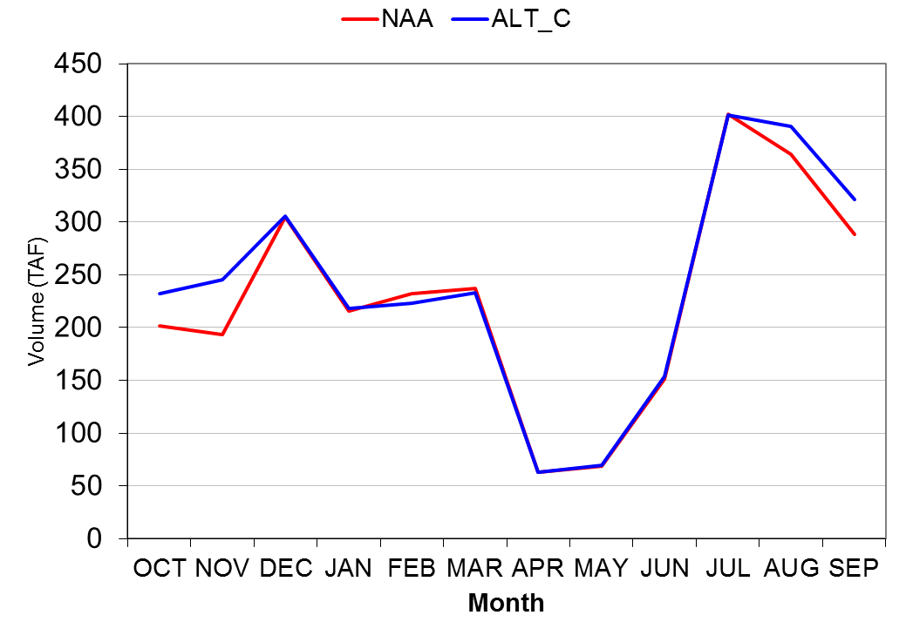
Water Supply Benefits: Monthly S. of Delta (DWR Alternative C) Exports

Slide 14
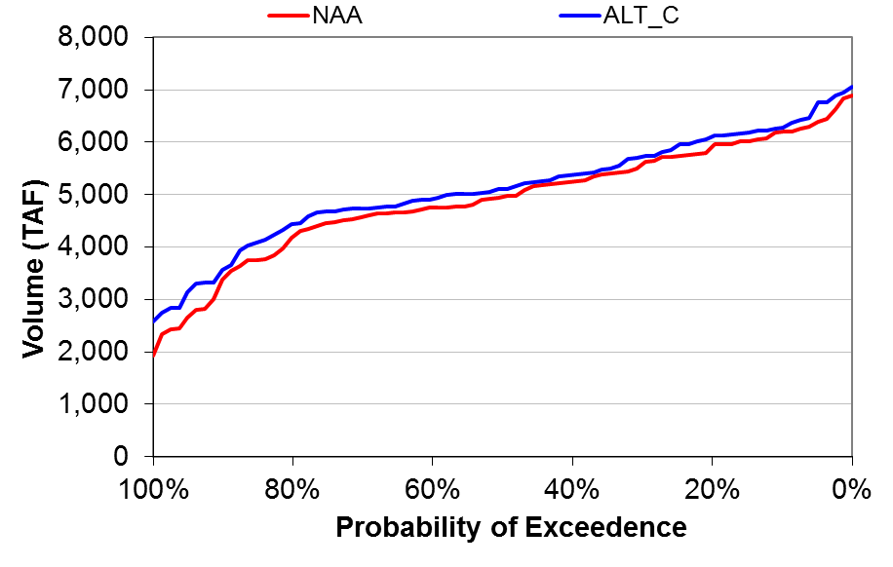
Water Supply Benefits: Export S. of Delta
(DWR Alternative C) (Annual)
Assumptions:
Water demand in year 2030
No change to COA
2009 BiOps w/ no additional changes
No change in SWRCB
Implementation of SGMA does not affect exports
DRY
AVERAGE
WET

Slide 15
Water Supply Benefits: South of Delta
Summary:
Improves the Delta’s ecology to
    (a) help address SWRCB concerns
    (b) increase exports & facilitate through-Delta transfers
Another source of water – independent of CVP & SWP contracts
Integrate Shasta releases (e.g. for cold water pool)
    Releases stored for later release during export window
CVP San Luis Unit:
  Increased supplies
  Reduce dependence on groundwater and help to mitigate the impacts of SGMA
Interruptible Water (CVP Section 215 & SWP Article 21):
    Could extend the duration (i.e. shoulder-loading)
Refuge Water

Slide 16
Proposition 1, Chapter 8
$ 2.7 Bn is available
Eligible Projects
CALFED & Groundwater Storage
Conjunctive Use and Reservoir Reoperation
Local and Regional Surface Storage
Eligible Public Benefits
Ecosystem Improvement
Water Quality Improvement
Emergency Response
Flood Control
Recreation
2016 January
Draft, planning phase concepts

Slide 17
Proposition 1, Chapter 8
Key Performance Measures:
“Priority will be given to projects that leverage private, federal, or local funding to produce the greatest public benefit.
§ 79707 (chapter 4)
Funds provided for “public benefits associated with water
storage projects that improve the operation of the state
water system, are cost effective, and provide a net
improvement in ecosystem and water quality conditions.” § 79750(b)
Projects selected “through a competitive public process
[ranked by] the [magnitude of the] expected return for
public investment.” § 79759(c)
The project provides “measureable improvement to
the Delta ecosystem or to tributaries to the Delta” § 79752
  The project “will advance the long-term objectives of
  restoring ecological health and improving water
  management for beneficial uses of the Delta” § 79755(a)(5)(B)
2016 January
Draft, planning phase concepts

Slide 18
Estimated Public Benefits
(DWR Alternative C)
2016 January
Draft, planning phase concepts

Slide 19
Project: Range of Construction Costs
  Reservoirs and Dams: $1. B - $1.5 B
  Pumping and
  Generating Plants: $1. B - $1.4 B
  Pipelines: $1. B - $1. B
  Total: $3. B - $4. B
  Unescalated
  w/o finance cost
  Includes contingency

Slide 20
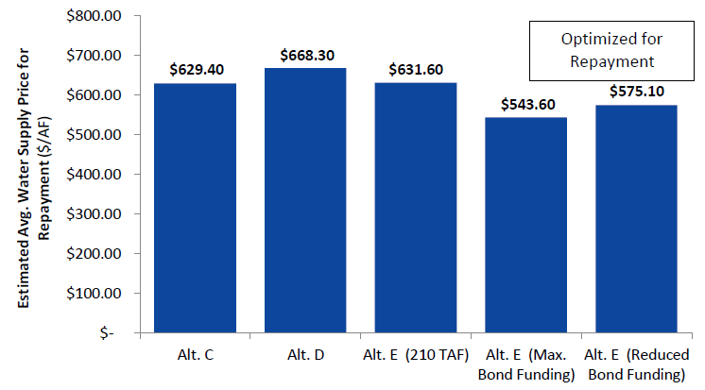
Costs/acre-ft. (with financing)
2016 January
Draft, planning phase concepts
* Price is FOB Sacramento River (North of Maxwell)

Slide 21


Project: Financing
Phase 1 (prepare Prop 1 application): Member-funded
50% (minimum) Water User Funded
50% (maximum) Public Benefit Funded
Repay sunk costs w/ interest
Phase 2 (complete Environmental Review): Member-funded &/or short-term debt
Current Sacramento Valley
Demand
Ecosystem
& Water Quality Enhancement
Repay sunk costs w/ interest
Phase 3 (complete final design & pre-construction activities): Member-funded &/or short-term debt
Additional Water Users
Cold
Water
Pool
All Other
Repay sunk costs w/ interest
Phase 4: (construction and start-up): long-term debt finance
NOTE: The earlier Prop 1 funds become available, the lower the project costs (i.e. reduce the carrying cost of the public benefit cost-share).
Taxpayers
(General Obligation Bonds)
Phase 5 (operations): Repayment

Slide 22



Project: Repayment
50% (minimum) Water User Funded
50% (maximum) Public Benefit Funded
Current Sacramento Valley
Demand
Ecosystem
& Water Quality Enhancement
Pumped-storage
($/kWh generated)
Water
($/acre-ft. of water)
Additional Water Users
Cold
Water
Pool
All Other
Carryover
(variable $/year)
NOTES:
A 40-year term is assumed for the repayment period (separately for water-user funded and public-benefit funded activities)
Water-user finance cost requires (a) power purchase contract, (b) water user contracts, (c) water right, and the entity's creditworthiness
Annual Use
(fixed $/year)
Taxpayers
(General Obligation Bonds)
Storage

Slide 23
Project: Phase Schedule
Phase 1:
CWC WSIP Application
Phase 2:
Final EIR/S & Preliminary engineering
Phase 3:
Permits, ROW, & Final Design
Phase 4:
Construction & Close-out
Phase 5:
Transfer to Ops
1
2
3
4
Tracks:
Project Management
Repayment
Secure short-term debt
Add’l short-term debt
Issue long-term debt
Direct funding by Members
Earliest date Prop 1, Chapter 8 Grant Funds available
Managing Public Benefits
Negotiate
Planning & Permitting
Prepare Proposal
Grant Awarded
Contract w/ DFW, SWRCB, & DWR
Acquire Permits pre-construction
Construction
Permits
Pre-public draft EIR/S
Draft EIR/S
Public Input
Final EIR/S
Engineering
Incorporate CWC Changes
Optimize
Feasibility
Preliminary
Final Design &
Contract Documents
Construction Management
Field Data Collection
Owner-furnished
Equipment
Target $/acre-ft.
Risk allocation, Financing, & Power Generation needs to be factored into pricing
Real Estate / Rights of Way
Temporary
Acquire Permanent Rights of Way
Bid/Award
Water Users
Construction & Commissioning
Public Benefit
Multiple Construction Packages
NOTE: The subsequent phase can only start once the Members have rebalanced the project and financing agreements are executed.
Commissioning
Notes:
Animation: 1-click to fill in phases 2 through 5

Slide 24
Project’s Risk & Uncertainty vs. Value
CWC Investment Grant Conditional Funding
Contracts with DFW. SWRCB,& DWR
Certified EIR/S
CWC Funding
Construction financing secured
Prop 1 bond funds for construction
Start-up testing complete
1
2
3
4
$$$ / share
High
+$$ / share
Risk & Uncertainty
$$ / share
Medium
South of Delta
Sacramento Valley & Delta
“Stock Value”
Low
$ / share
Residual
¢ / share
Time (years)
NOTE: Cost to buy-in, if water is even available, increases over time

Slide 25
Governance Structure (simplified)
Authority Annualized
Members (10) Acre-Ft.
Colusa County
Glenn County
Maxwell ID
Tehama-Colusa
Canal Authority
Colusa Co. WD 30,000
Glenn-Colusa ID 20,000
Orland-Artois WD 20,000
Proberta WD 3,000
Reclamation
District 108 ⁽¹⁾ 20,000
Westside WD 25,000
Sites Project Authority (10)
Voting: 1 member, 1 vote
Ex Officio (DWR) & USBR
Advisory
Yolo Co. FC&WCD
Project Agreement Committee
100% Before Prop 1 Funds Awarded
Represented
Members Acre-Ft.
Cortina WD 300
Davis WD 2,000
Dunnigan WD 5,000
LaGrande WD 3,000
Other Sac. Valley WD TBD
Non-Sac Valley, M&I TBD
Non-Sac Valley, Agriculture TBD
Voting: pro-rated by acre-ft.
Dams
Pumping
Pipelines
Intakes & Diversions
2016 January
Draft, planning phase concepts

Slide 26
Governance: Decision Making
Authority’s Role:
The applicant for Proposition 1, Chapter 8 grant
The CEQA lead agency and work with USBR as the NEPA lead agency
Hold title to any water rights issued by SWRCB
Obtain permits & acquire property, easements and rights-of-way
Be the owner of record for dam safety requirements and regulatory obligations.
May delegate (or rescind) responsibilities to a Project Agreement Committee
Sites Project Authority
Delegations of Authority
Project Agreement Committee
Project Agreement Committee:
Requires a minimum of 2 Authority Members execute each Project Agreement. The Authority is also signatory to each Project Agreement.
Comply with terms and conditions established by the Authority in the Reservoir Project Agreement.
Maintain sufficient reserves to ensure a positive cash flow.
For Phase 1, manage the studies and related materials that will be required in the application for funding in compliance with Proposition 1, Chapter 8 requirements.
Dams
Pumping
Pipelines
Intakes & Diversions

Slide 27
Why Invest (Now vs. Later):
Topic Now: Later: (after Phase 1)
Water Supply: Secure a 1st right w/ ability to Acquire water only if a Member
acquire more. elects to reduce their amount.
Cost/acre-ft. Is the same for all Members Increased cost to buy-in, which is based on time value of investment
and project’s ‘stock value’.
Operations & Able to shape & define how Little to no ability to change. Final
Public Benefits much water to make available operations will be ‘run’ to validate
for Public Benefits & contract benefits & allocation and to fulfill Terms vs. for water supply CEQA/NEPA and ESA requirements
Water Able to help ensure the None. Details will have already been
Commission process results in the least defined and converted into
cost/acre-ft. with appropriate regulations.
risk allocation
Contracts vs. Able to define contract terms & None. Details will have already permit conditions conditions with DFW, SWRCB, & been defined and converted into
DWR vs. what will become contract language
permit conditions
Project’s scope, Able to shape the project None. Will have to accept the
schedule, cost & requirements & how risks project requirements as a condition
Risk allocation are allocated and managed of becoming a Member
New water storage only happens with 100% water user support now

