Slide 1
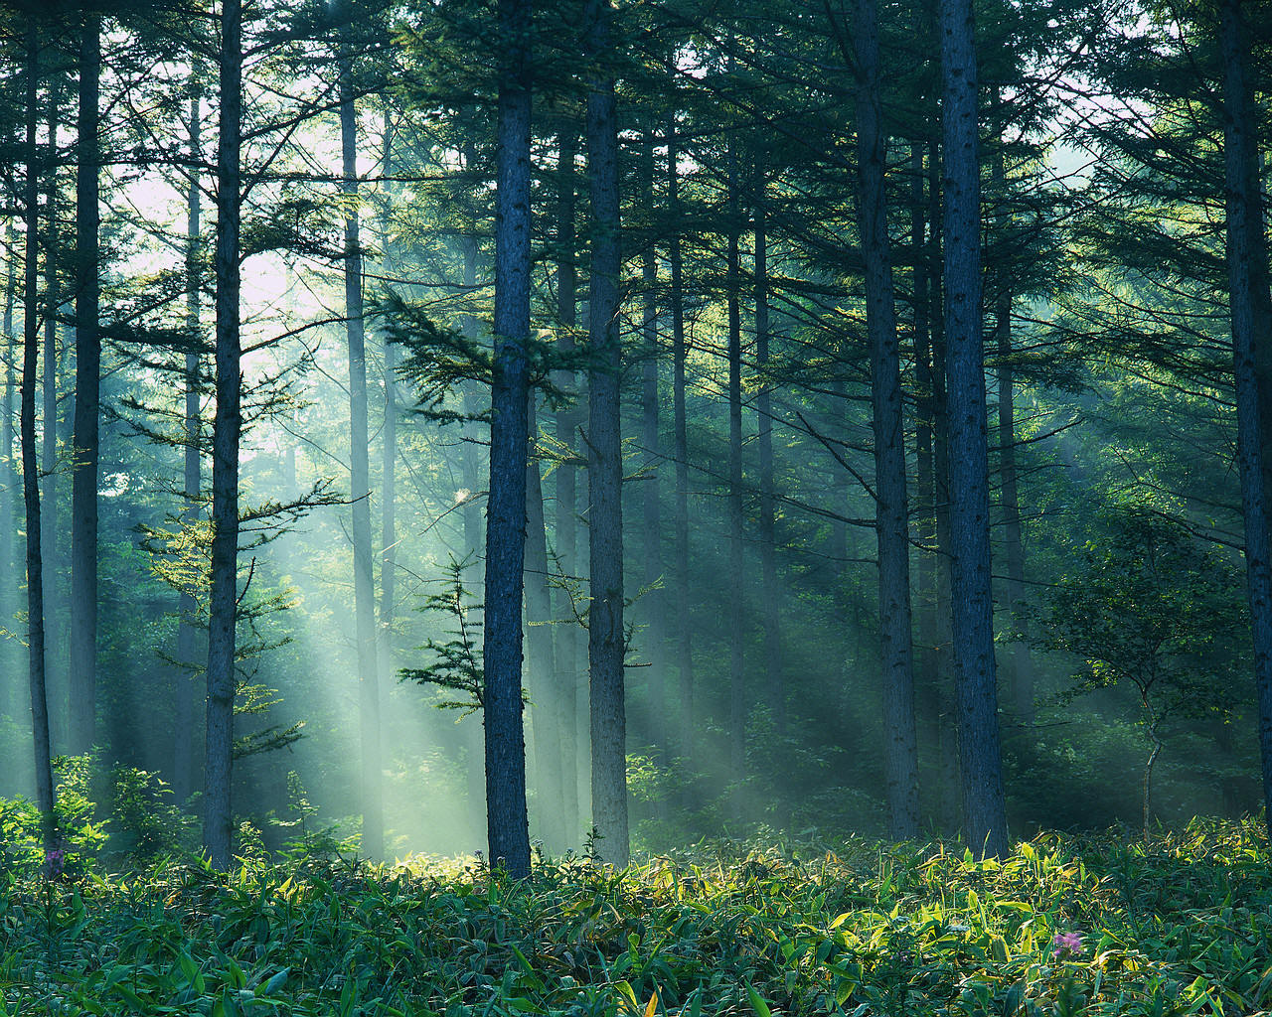
National Forests
Are Much More Than Meets the Eye
“It is not so much for its beauty that the forest makes a claim upon men's hearts, as for that subtle something, that quality of air that emanates from old trees, that so wonderfully changes and renews a weary spirit.” - Robert Louis Stevenson

Slide 2
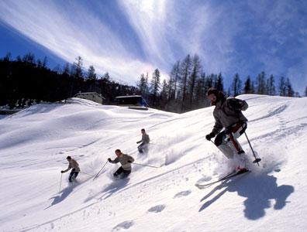
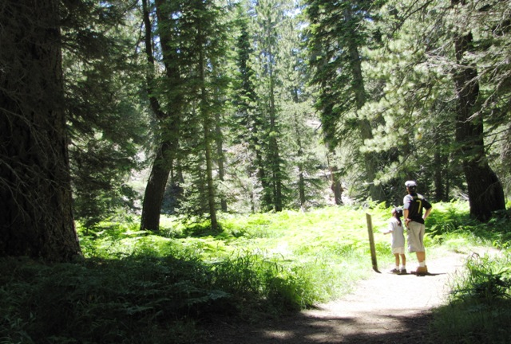
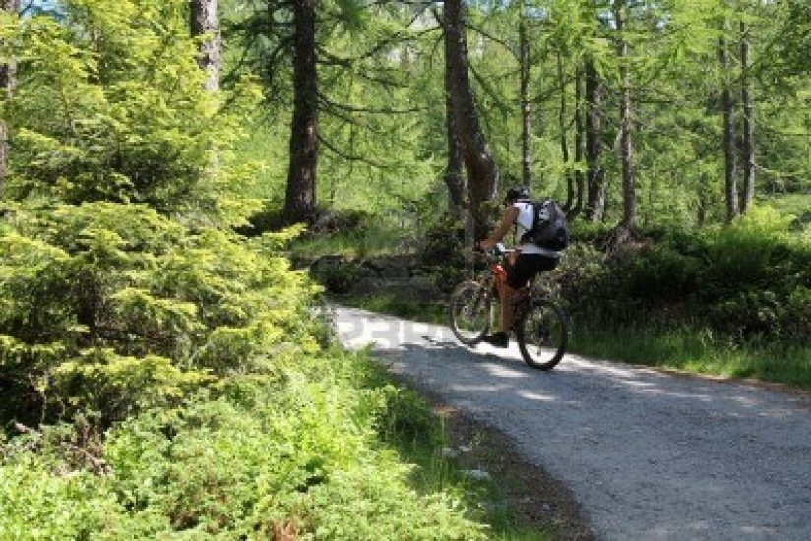
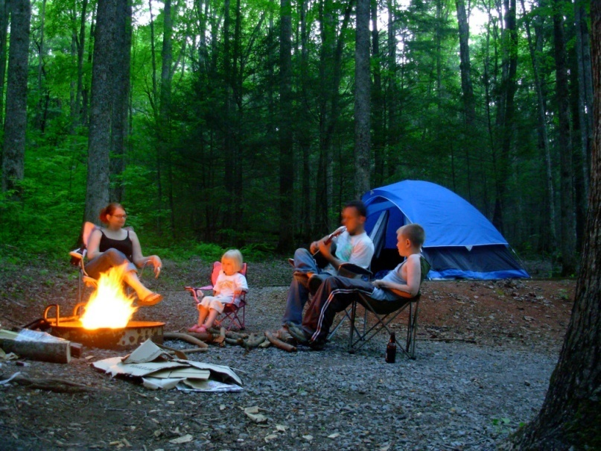
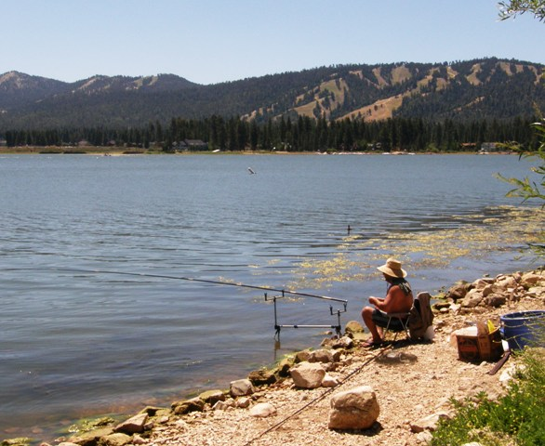
Beyond the Trees, Forests Offer Many Different Recreational Benefits
Winter Sports
Hiking
Biking
Camping
Off Road Vehicles
Fishing

Slide 3
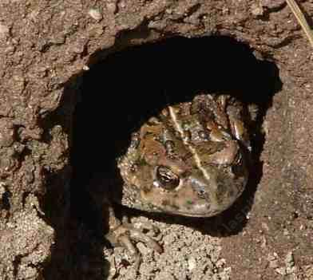
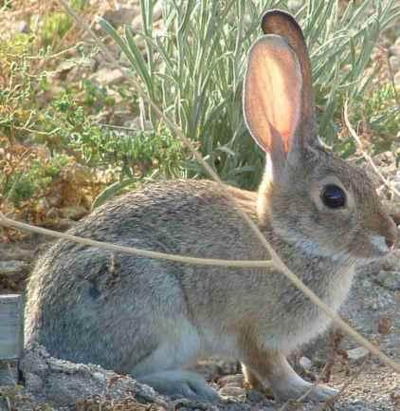
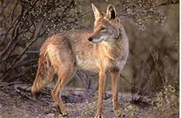
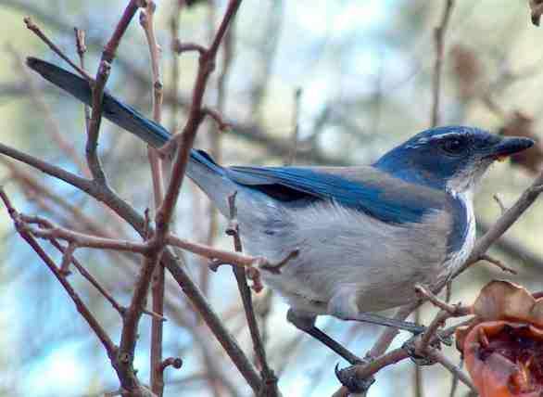
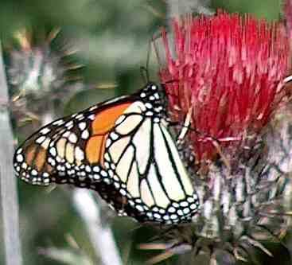
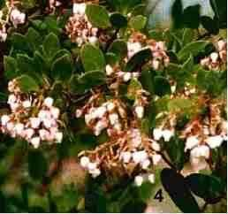
Forests Provide a Variety of Habitat Needs for Many Animal and Plant Species
The San Bernardino and Cleveland National Forests are home to over 440 wildlife species & thousands of plant species (over 30 of which are threatened or endangered.)
Habitat Benefits:
Important Linkages to Protected Areas
Botanical Transfer
Promotes Genetic Diversity

Slide 4
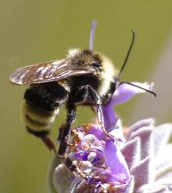
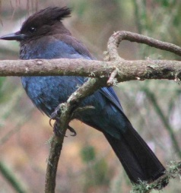
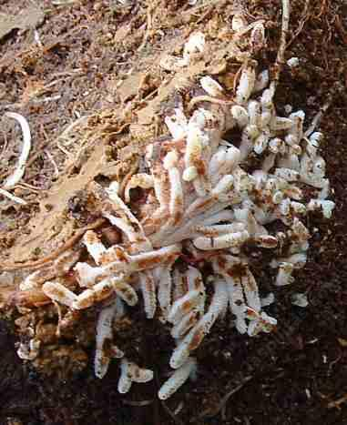
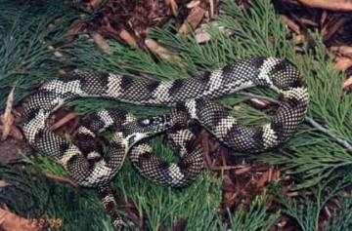
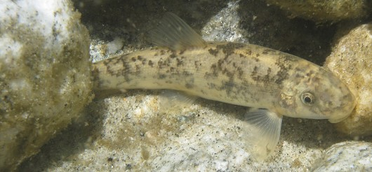
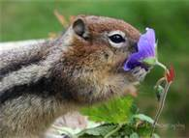
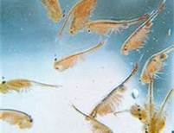
The Forest as a Vital Ecosystem
Climate
Plant Communities
Insect and Fungal Communities
Animal
Communities
Birds
Precipitation
Elevation
Aquatic Communities
Reptiles
Soil Properties
Mammals
Food Chain

Slide 5
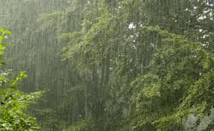
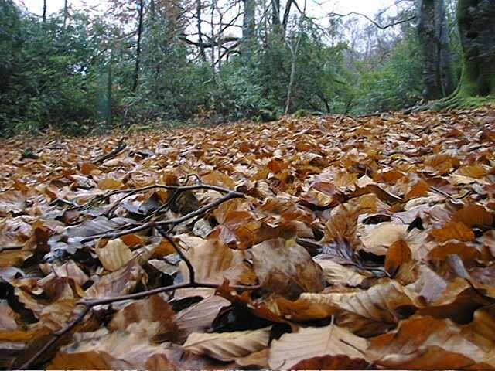
Forests are Vital to Local Water Resources
Quantity:
90% of Precipitation in the Santa Ana Watershed falls in forest areas contributing to groundwater replenishment.
Approximately 54% of the water used in the watershed comes from groundwater sources.
Quality:
Trees hold snow and allow it to melt slowly so that tributary streams are fed more slowly over time to allow for slow groundwater recharge
which improves purification.
Leaf litter can also store large quantities of water promoting percolation and purification.

Slide 6
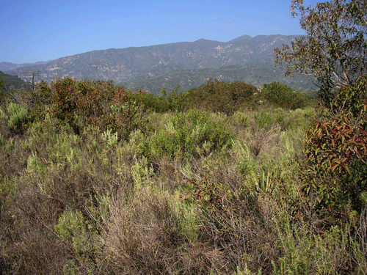
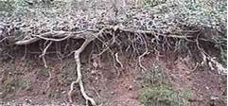
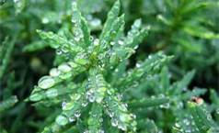
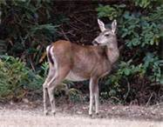
Chaparral Also Has an Important Function
Native plants have root systems that have a unique ability to interconnect underground for added stability and have a symbiotic relationship with microorganisms that produce tiny threads that both penetrate and bind soil particles together.
Chaparral serves to diffuse rainfall to promote percolation and prevent excessive runoff and provides valuable habitat to wildlife.

Slide 7
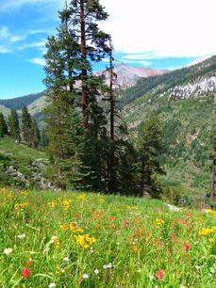
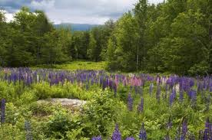
Forest Meadows Capture Water
Meadows act as natural water storage reservoirs which enhance water retention & promote groundwater recharge.

Slide 8
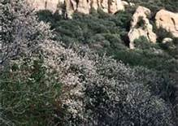
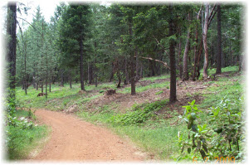
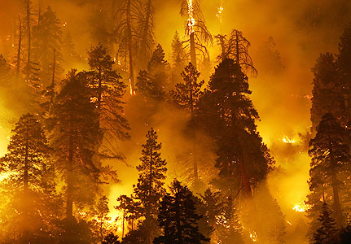
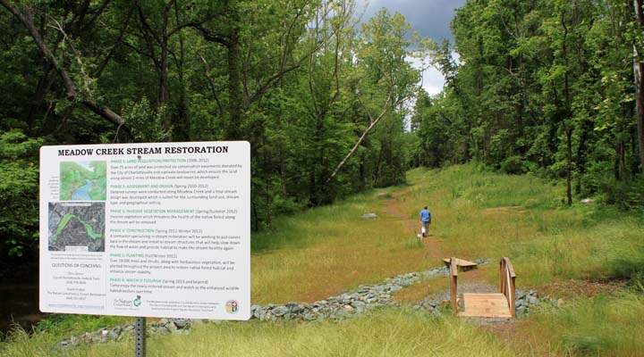
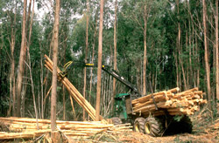
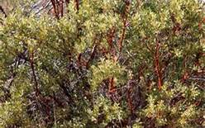
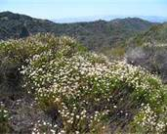
The Forest Ecosystem is Vulnerable but Manageable
Threat of fire can be managed by periodic thinning and controlled burns to prevent an over accumulation of fuel which, if a fire occurs, increases the fire’s intensity making it much more difficult to fight resulting in a greater potential for severe damage.
Limit human encroachment into sensitive habitat areas by providing designated access , trash receptacles and promote education about the benefits of conservation.
Replant native chaparral plant communities where grasses have taken over to restore habitat, reduce erosion and prevent runoff.
Meadows that have ceased to function can be restored to improve water retention.

Slide 9
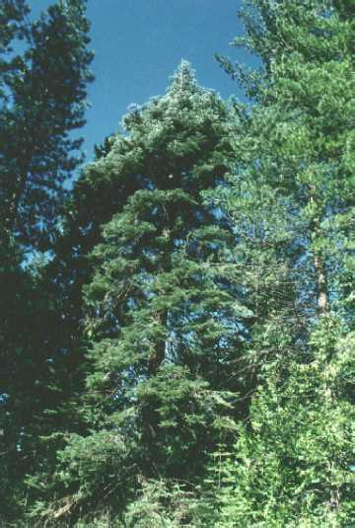
Questions ?
Forest Insight
"The forest is a peculiar organism of unlimited kindness and benevolence that makes no demands for its sustenance and extends generously the products of its life and activity; it affords protection to all beings." - Buddhist Sutra

